Slide 1
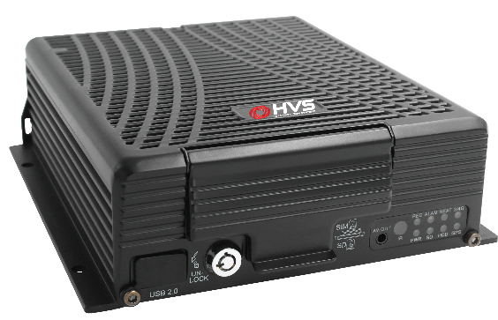
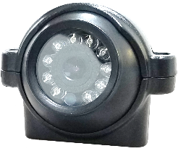
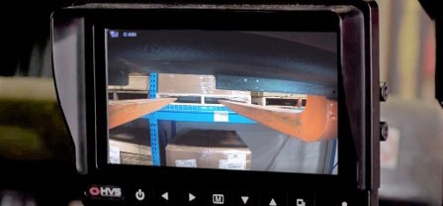
(616) 494-9974
11301 James Street
Holland, MI 49424
hollandvisionsystems.com
HD Recording/ Video Monitoring System
IDVR-TH
Flexible | Reliable | Mobile Video Recording For Industrial Operations
The IDVR-TA is a state-of-the-art 1080p HD camera systems designed to allow video monitoring of industrial operations.
Recording, live viewing, and automatic data backup is easy using the built-in Wi-Fi radio and the included central management software
The camera has a cast metal housing to withstand hard usage.
The 802.11 wireless link allows the image to be viewed live or recorded on a variety of devices
System can be configured with up to four cameras
An LCD monitor for the operator can be included, and system configurations are tailored to the application.
One year warranty.
YOU :
Visit our website for more information!
HVS9353A
©2022

Slide 2
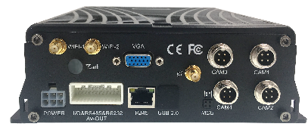
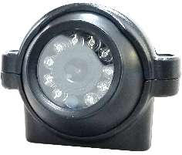
(616) 494-9974
11301 James Street
Holland, MI 49424
hollandvisionsystems.com
HD Recording/Video Monitoring System
Specifications:
IDVR-TH
Camera Sensor | 1/3” CMOS AR0130
Max Resolution | 1920 x 1080 @ 30fps
Lens | 3.6mm Standard, Other Options
Shock & Vibration | 10G
Signal Type | 1080P AHD
S/N Ratio | 50dB Min. (AGC off)
Min. Illumination | 0.0 Lux (IR LED Optional)
Housing | Camera: Cast Aluminum Recorder: Aluminum
Camera Capacity | 4
Recorder Storage | 2TB Max HDD
Color | Black
Power Supply | Voltage Options, 10W
Operating Temp | Camera: -4ºF - 122ºF (-20ºC - 50ºC)
Dust And Moisture Resistance | Indoor Model Standard; Weather-Resistant Optional
Dimensions | Camera: 2.4 x 2.2 in. (60 x 55mm) Recorder: 8.0 x 6.0 x 3.0 in. (203 x 150 x 76 mm)
Wireless Protocol | 802.11b/g/n 5.8GHz and 2.4GHz (WPA2-PSK, No RADIUS Server)
RECORDER
Connections
will vary
MONITOR
MONITOR
Optional Monitor
CAMERA
CAMERA
1 to 4 Turret style HD
Cameras
YOU :
WI-FI
WI-FI link
Visit our website for more information!

Slide 3
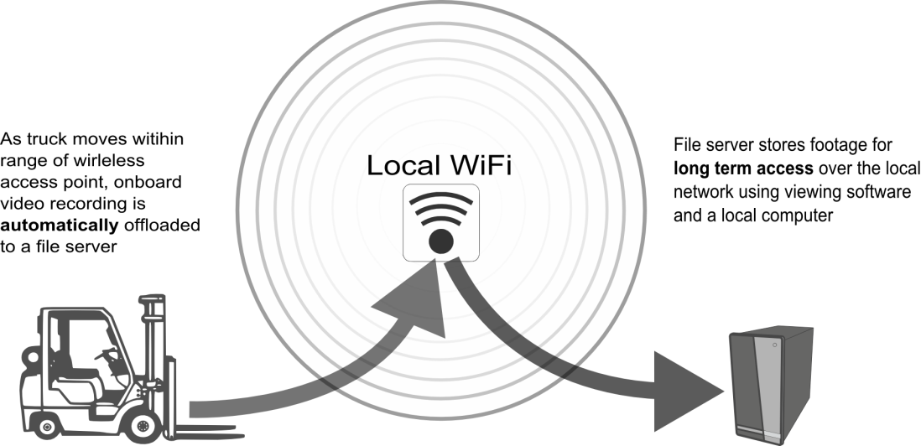
(616) 494-9974
11301 James Street
Holland, MI 49424
hollandvisionsystems.com
Weather-Resistant HD Recording System
Network Capabilities:
IDVRW-TH
Video Compression | H.264
Server Resolution | 1080p IPC/720p, 960H/P, D1
Frame Rate | 30 fps
Video Streaming | Multiple, individually configurable streams in H.264 and MJPEG; Controllable frame rate and bandwidth
Edge Recording | Mobile hard drive, 2TB Max Support for export to network storage
Event Triggers | External Inputs, Video Loss
Supported Protocols | 802.11 5.8/2.4GHz, / 3G / 4G Available
Max TX Power | 18 dBm
TX/RX Processor Specs | Atheros MIPS 24KC, 400MHz, 32 MB DDR1
Automatic onboard recording ensures capturing accidents, property damage, and driver behavior
Network Connection Optional for long-term storage and live viewing – flexible data management including zero bandwidth usage and cloud storage options
On-Demand Live Viewing & Playback – Connect using Wi-Fi for live viewing of new operators or for playback after an incident
Scheduled Export Option – Choose to export recordings at night or on Sundays, avoiding work times
Opportunity Offloading to a PC or file server can be selected. Small file sizes can export automatically whenever in an area with Wi-Fi coverage. *See Illustration Below
Easy-To-Use Windows® client software for live viewing and playback.
YOU :
As the truck moves within range of a wireless access point, video recordings are automatically offloaded to a file server

