Slide 1
HIGHER OR LOWER?
A SAFETY STATISTICS GAME

Slide 2
HOW TO PLAY
INTERACTIVE SAFETY RESOURCES
A safety statistic will be shown. The number in the statistic is incorrect. It is your job to guess if the true statistic is higher or lower than that number. To show your guess is higher, give a “thumbs up”. To show your guess is lower, give a “thumbs down”.

Slide 3
READY?

Slide 4
HIGHER OR LOWER?
On average, there are 72 deaths per year due to forklift accidents.
Higher or lower?

Slide 5
ANSWER: HIGHER
On average, there are 87 deaths per year due to forklift accidents.
This highlights the importance of forklift safety and following proper procedure to ensure everyone’s safety.
Source: https://www.osha.gov/laws-regs/federalregister/1995-03-14

Slide 6
HIGHER OR LOWER?
A forklift overturning is the most common incident, accounting for 35% of all forklift accidents.
Higher or lower?

Slide 7
ANSWER: LOWER
A forklift overturning is the most common incident, accounting for 25% of all forklift accidents.
This emphasizes how vital it is to follow safety procedures in order to avoid bad accidents. Major accidents are more common than you might think.
Source: https://www.osha.gov/laws-regs/federalregister/1995-03-14

Slide 8
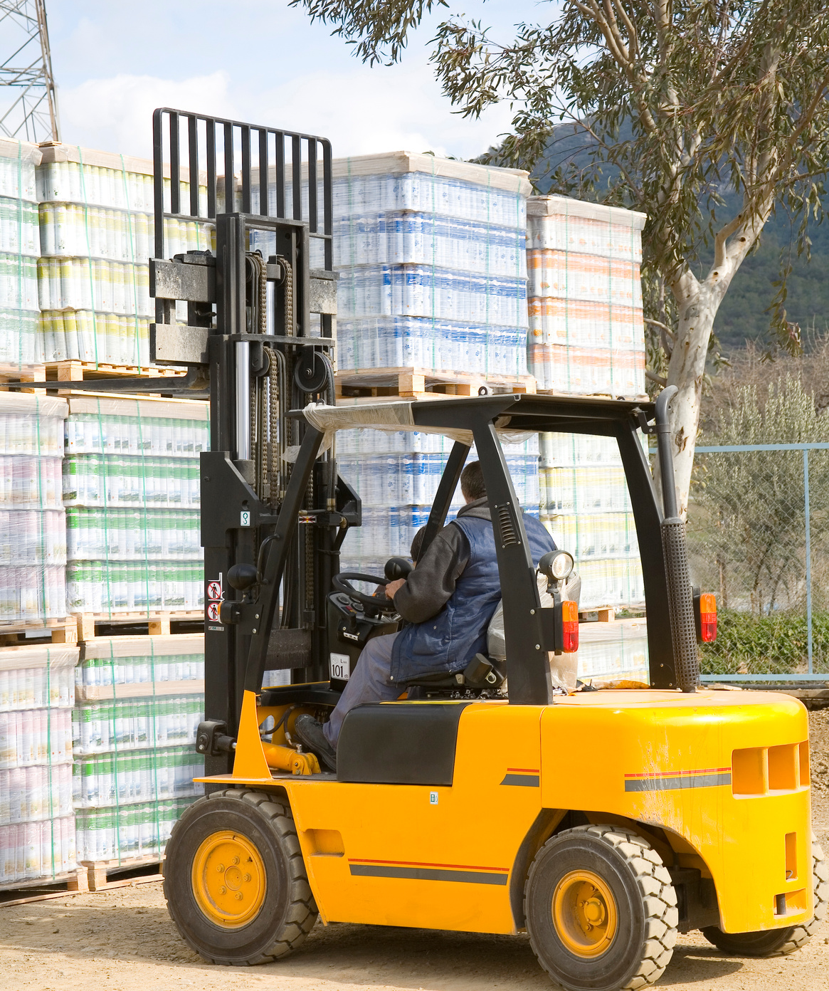
HIGHER OR LOWER?
Approximately 6% of forklifts in the United States will be involved in an accident each year.
Higher or lower?

Slide 9
ANSWER: HIGHER
Approximately 11% of forklifts in the United States will be involved in an accident each year.
This means if your facility has 10 or more – something is going to happen this year. How can we decrease that number?
Source: https://www.osha.gov/laws-regs/federalregister/1995-03-14

Slide 10
HIGHER OR LOWER?
If companies implemented more stringent training policies, the Occupational Safety & Health Administration (OSHA) estimates that about 50% of forklift accidents in the US could be prevented.
Higher or Lower?

Slide 11
ANSWER: HIGHER
If companies implemented more stringent training and policies, the Occupational Safety & Health Administration (OSHA) estimates that about 70% of forklift accidents in the US could be prevented.
Trainings like this can make a huge impact on decreasing accidents and increasing safety!
Source: https://www.osha.gov/laws-regs/federalregister/1995-03-14

Slide 12
Summary
What Have We Learned
1
Take Safety Seriously
Workplace safety is a serious topic and many deaths occur each year. We can work together to avoid a tragedy.
2
Accidents are Common
Accidents are more common than we think - we need to keep this in mind and take measures to avoid them and know how to handle them if they do occur.
3
Awareness Decreases Accidents
Simply being aware and participating in safety trainings can help decrease accidents. Let’s work together to create a safe environment.

