Slide 1
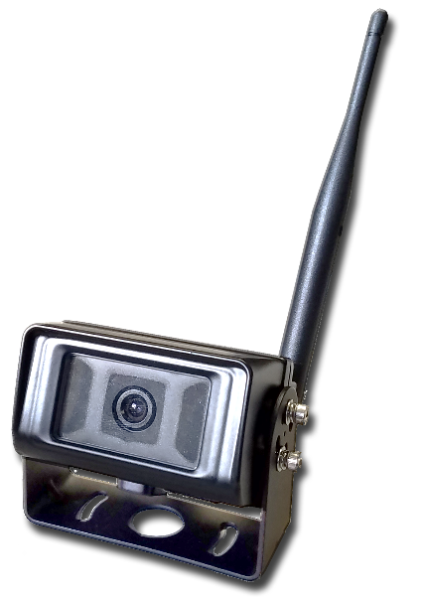
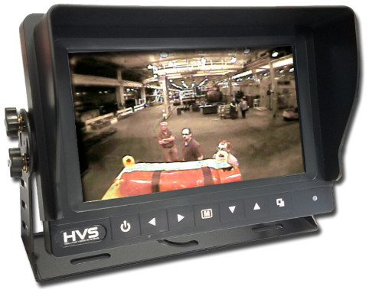
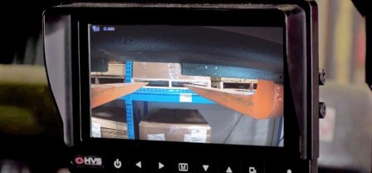
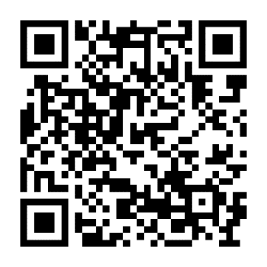
(616) 494-9974
11301 James Street
Holland, MI 49424
hollandvisionsystems.com
Wireless Camera System
M7W-D
M7W-D
Wireless | Weatherproof | Reliable Camera for your Rugged Operations
The IDVRW-Tx is a weatherproof camera system designed to allow video monitoring of material handling operations.
The DVR is sealed against dust and moisture so it can be used in outdoor operations.
Its solid-state hard drive provides long-term storage, and it is protected by a locked door for data security.
Remote live viewing and automatic wireless backup of recordings to a PC is possible using the included software.
Four cameras with megapixel HD resolution can be connected, with audio and LED lighting options.
System configurations are tailored to the application.
One year warranty.
YOU :
Visit our website for more information!
HVS9353A
©2022

